Slide 1
Azure Cosmos DB App Dev Workshop Build real-time apps with Azure Cosmos DB, Azure Functions, Azure Databricks and Power BI

Slide 2
Modern apps face new challenges
Managing and syncing data distributed around the globe
Delivering highly-responsive, real-time personalization
Processing and analyzing large, complex data
Scaling both throughput and storage based on global demand
Offering low-latency to global users
Modernizing existing apps and data

Slide 3
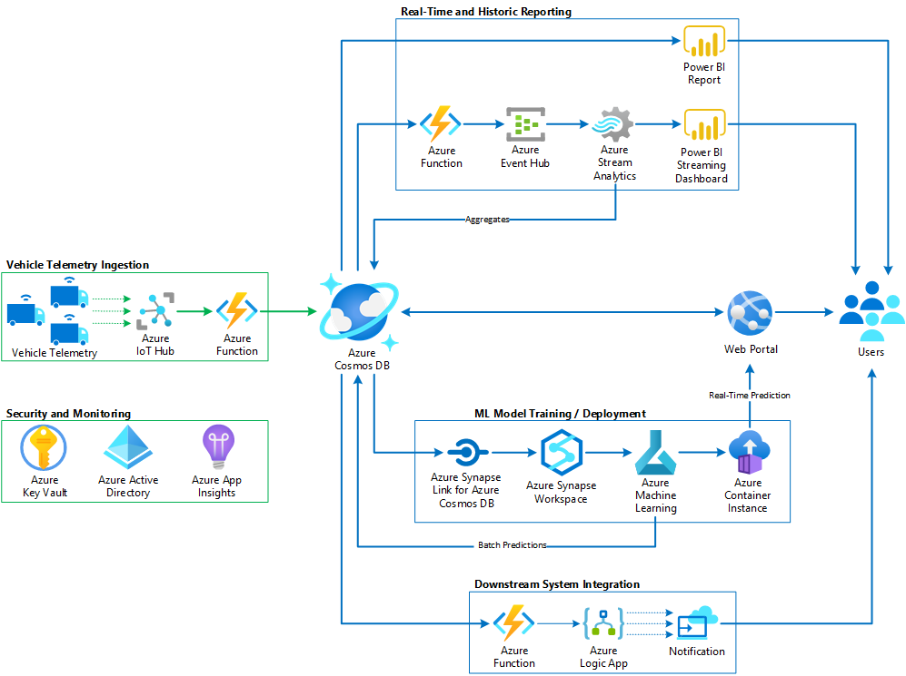
Our scenario
IoT – streaming vehicle telemetry

Slide 4
Our scenario
IoT – build a web app backed by Cosmos DB

Slide 5
Our scenario
IoT – predictive maintenance on historical data

Slide 6
Our scenario
IoT – streaming vehicle telemetry

Slide 7
What you will do in the lab
Scenario: IOT Streaming Vehicle Telemetry
The solution will:
Ingest streaming vehicle telemetry into Cosmos DB at high rate
Track & monitor vehicles and package deliveries in real-time
Build & deploy a machine learning model for predictive maintenance on vehicle battery failure (optional)

Slide 8
Azure Cosmos db
A FULLY-MANAGED GLOBALLY DISTRIBUTED DATABASE SERVICE BUILT TO GUARANTEE
EXTREMELY LOW LATENCY AND MASSIVE SCALE FOR MODERN APPS AND OPERATIONAL ANALYTICS

Slide 9





AZURE COSMOS DB
Core (SQL) API
Table API
MongoDB
Column-family
Document
Key-value
Graph
Guaranteed low latency at the 99th percentile
Elastic scale out
of storage & throughput
Five well-defined consistency models
Turnkey global distribution
Comprehensive SLAs

Slide 10
Top 10 reasons why customers use Azure Cosmos DB
The 1st and only database with global distribution turnkey capability
Deliver massive storage/throughput scalability database
Provides guaranteed single digit millisecond latency at 99th percentile worldwide
Natively supports different types of data at massive scale
Boasts 5 well-defined consistency models to pick the right consistency/latency/ throughput tradeoff
Enables mission critical intelligent applications
Gives high flexibility to optimize for speed and cost
Tackles big data workloads with high availability and reliability
Provides multi-tenancy and enterprise-grade security
Naturally analytics-ready and perfect for event-driven architectures
Notes:
Massive scale: unlimited storage and throughput
Mission critical: because of our industry-leading SLAs
Optimize speed and cost: elastic throughput (1+ million scale up/down per day)
High availability: 7 9s actually

Slide 11
Powering global solutions
Azure Cosmos DB was built to support modern app patterns and use cases.
It enables industry-leading organizations to unlock the value of data and respond to global customers and changing business dynamics in real-time.
Data distributed and available globally
Build real-time customer experiences
Ideal for gaming, IoT & eCommerce
Simplified development with serverless architecture
Run Spark analytics over operational data
Lift and shift NoSQL data
Puts data where your users are
Enable latency-sensitive personalization, bidding, and fraud detection.
Predictable and fast service, even during traffic spikes
Fully-managed event-driven micro-services with elastic computing power
Accelerate insights from fast, global data
Lift and shift MongoDB and Cassandra workloads

Slide 12
Lab: Run Setup scripts
https://aka.ms/CosmosIOTLab
If you need a subscription/environment:
Sign-Up Link: http://bit.ly/3bVvIss
Activation Code: ACTIVATE5890
Click “Launch Lab”
WIFI: Cliftons Training; AKL@TR4-07
Make sure to save Azure Portal and VM access credentials
Notes:
Sydney

Slide 13
Lab: Run Setup scripts
”
If you need a subscription/environment:
Sign-Up Link: aka.ms/CosmosLabLink
Activation Code: ACTIVATE5902
Click “Launch Lab”
Make sure to save Azure Portal and VM access credentials
Notes:
Melbourne

Slide 14
What are Request Units (RUs)?

Slide 15
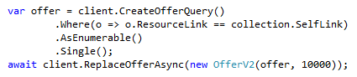
What are Request Units (RUs)?
In Cosmos DB, expected performance must be provisioned
Expressed in Request Units per second (RU/s)
Represents the "cost" of a request in terms of CPU, memory and I/O
Performance can be provisioned:
at the database-level
at the collection-level
or both
Provisioned performance can be changed programmatically with API calls

Slide 16
What are Request Units (RUs)?
Each request consumes # of RU
1 RU = 1 read of 1 KB document
5 RU = 1 write of a 1KB document
Query: Depends on query & documents involved
(Indexing also affects RU cost)
GET
=
POST
=
PUT
=
Query
=
…

Slide 17
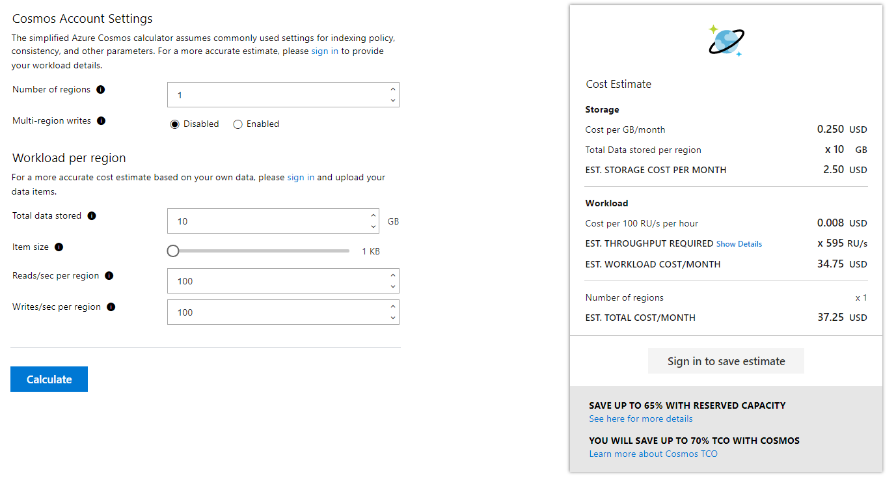
How to estimate RU/s
Demo: cosmos.azure.com/capacitycalculator

Slide 18
Partitioning

Slide 19
Why do we partition in the first place?
Scale
Instead of buying larger machines (scaling up) we distribute our data across multiple machines
Each machine is responsible for serving subset of the data.
Analogy: Working in a team

Slide 20
Partitioning Definitions
Logical partition: Stores all data associated with the same partition key value
Physical partition: Fixed amount of reserved SSD-backed storage + compute.
Cosmos DB distributes logical partitions among a smaller number of physical partitions.
From user’s perspective: define 1 partition key per container

Slide 21
Partitions
hash(vin)
….
Partition 1
Partition 2
Partition N
Range 1
Range 2
Range X

Slide 22
Partitions
Documents with same partition key value (vin) are in same logical, physical partition
hash(vin)
ABC123
XYZ999
….
ABC123
EFJSF
DFJDFP
XYZ999
IKDI3
Partition 1
Partition 2
Partition N
Range 1
Range 2
Range X

Slide 23
Partitions
Automatically split when close to full
hash(vin)
….
ILHFD
BHDN
…
EBHFI
…
ABC123
EFJSF
ILHFD
+
DFJDFP
XYZ999
BHDN
IKDI3
Partition x2
EBHFI
Partition x1
Partition 1
Partition 2
Partition N
Range X1
Range X2
Range 1
Range 2
Range X

Slide 24
Partitions
Cosmos DB distributes RU/s evenly across physical partitions
30,000 RU/s
hash(vin)
6000 RU/s
6000 RU/s
6000 RU/s
Max logical partition size: 10GB
Max logical partition RU/s: 10k RU/s
….
ABC123
EFJSF
ILHFD
DFJDFP
XYZ999
BHDN
IKDI3
EBHFI
Partition 1
Partition 2
Partition 5
Range 1
Range 2
Range 5

Slide 25
How you should think about partition keys
All partition keys should have these properties:
Evenly distributes requests
Evenly distributes storage
Has a high cardinality
Is included in the filter of your most frequent query
Is the logical boundary for stored procedures

Slide 26
How you should think about partition keys
All partition keys should have these properties:
Evenly distributes requests
Evenly distributes storage
Has a high cardinality
Is included in the filter of your most frequent query
Is the logical boundary for stored procedures

Slide 27
How you should think about partition keys
All partition keys should have these properties:
Evenly distributes requests
Evenly distributes storage
Has a high cardinality
Is included in the filter of your most frequent query
Only relevant for read-heavy workloads

Slide 28

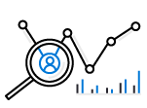

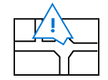

Warm-up: Partition Design
EXAMPLE SCENARIO
Contoso Connected Car is a vehicle telematics company. They are planning to store vehicle telemetry data from millions of vehicles every second in Azure Cosmos DB to power predictive maintenance, fleet management, and driver risk analysis.
WHAT ARE A FEW POTENTIAL PARTITION KEY CHOICES?
Example – Contoso Connected Car
Notes:
Design Goals for Choosing a Good Partition Key
Distribute the overall request + storage volume
Avoid “hot” partition keys
Partition Key is scope for [efficient] queries and transactions
Queries can be intelligently routed via partition key
Omitting partition key on query requires fan-out
Steps for Success
Ballpark scale needs (size/throughput)
Understand the workload
# of reads/sec vs writes per sec
Use 80/20 rule to help optimize bulk of workload
For reads – understand top X queries (look for common filters)
For writes – understand transactional needs understand ratio of inserts vs updates
General Tips
Don’t be afraid of having too many partition keys
Partitions keys are logical
More partition keys => more scalability

Slide 29
What are some potential partition key choices?
Vehicle Model
Current Time
Device Id
Composite Key – Device ID + Current Time

Slide 30
Partition Key Choices
VEHICLE MODEL (e.g. Model A)
Most auto manufactures only have a couple dozen models. This will create a fixed number of logical partition key values; and is potentially the least granular option.
Depending how uniform sales are across various models – this introduces possibilities for hot partition keys on both storage and throughput.
CURRENT MONTH (e.g. 2018-04)
Auto manufacturers have transactions occurring throughout the year. This will create a more balanced distribution of storage across partition key values.
However, most business transactions occur on recent data creating the possibility of a hot partition key for the current month on throughput.
Storage Distribution
Throughput Distribution
Storage Distribution
Throughput Distribution
Rodel
Rodel
2018-03
2018-03
Prisma
Prisma
2018-04
2018-04
Turlic
Turlic
2018-05
2018-05
Coash
Coash
2018-06
2018-06
Example – Contoso Connected Car

Slide 31
Partition Key Choices
DEVICE ID (e.g. Device123)
Each car would have a unique device ID. This creates a large number of partition key values and would have a significant amount of granularity.
Depending on how many transactions occur per vehicle, it is possible to a specific partition key that reaches the storage limit per partition key
COMPOSITE KEY (Device ID + Time)
This composite option increases the granularity of partition key values by combining the current month and a device ID. Specific partition key values have less of a risk of hitting storage limitations as they only relate to a single month of data for a specific vehicle.
Throughput in this example would be distributed more to logical partition key values for the current month.
Storage Distribution
Throughput Distribution
Storage Distribution
Throughput Distribution
C49E27EB
C49E27EB
C49E27EB-2018-05
C49E27EB-2018-05
FE53547A
FE53547A
C49E27EB-2018-06
C49E27EB-2018-06
E84906BE
E84906BE
4376B4BC-2018-05
4376B4BC-2018-05
4376B4BC
4376B4BC
4376B4BC-2018-06
4376B4BC-2018-06
Example – Contoso Connected Car

Slide 32
Example from lab: “telemetry” collection
We use a property “/partitionKey”
Partition key: vin_year_month
Why?
High cardinality for high write ingest
Won’t hit 10GB logical partition key value
Can still query on VIN:
SELECT * FROM c WHERE c.partitionKey IN (…)
Optimizes for write-heavy scenario
{
"partitionKey": "PB2GAMT1UBQC0N2BW-2019-10",
"entityType": "VehicleTelemetry",
"ttl": 5184000,
"tripId": null,
"vin": "PB2GAMT1UBQC0N2BW",
"state": "MN",
"region": null,
"odometer": 27929.01,
…
"refrigerationUnitKw": 69.99,
"refrigerationUnitTemp": 17.49,
"timestamp": "2019-10-20T04:46:52.6877746Z",
"id": "9c5cb3b6-d47c-4625-b925-460e23a0a0f1"
}

Slide 33
Example from lab: “telemetry” collection
We tune the indexing policy to reduce RU charge on writes
Only index vin, state, partition key
Why?
Indexing fewer properties reduces RU charge on writes
Increase # writes/sec for same provisioned RU/s
Optimizes for write-heavy scenario
{
"indexingMode": "consistent",
"automatic": true,
"includedPaths": [
{"path": "/vin/?"},
{"path": "/state/?"},
{"path": "/partitionKey/?"}
],
"excludedPaths": [
{"path": "/*"},
{"path": "/\"_etag\"/?"}
]
}

Slide 34
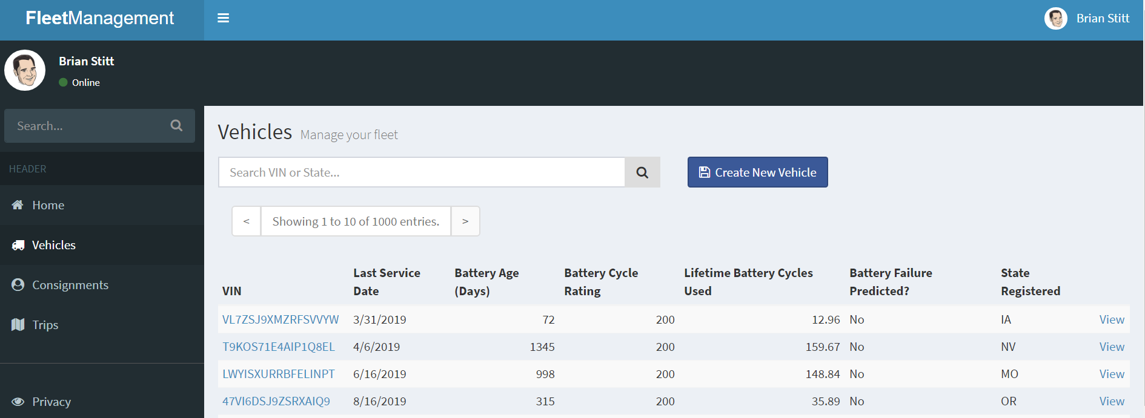
Example from lab: “metadata” collection
Vehicle entity type – partitioned by VIN
Why? Supports efficient point read lookups on website
Optimizes for read-heavy scenario
[
{
"id": "b2910b2c-d3c9-4120-bd50-7d7562a81d65",
"partitionKey": "VL7ZSJ9XMZRFSVVYW",
"entityType": "Vehicle",
"vin": "VL7ZSJ9XMZRFSVVYW",
"lastServiceDate": "2019-03-31T04:45:44.7345362Z",
"batteryAgeDays": 72,
"batteryRatedCycles": 200,
"lifetimeBatteryCyclesUsed": 12.956848687191329,
"averageDailyTripDuration": 63.366859026769184,
"batteryFailurePredicted": false,
"stateVehicleRegistered": "IA",
"_attachments": "attachments/",
}
]

Slide 35
In general…
If workload is read heavy…
Try to partition so you can do point reads (ReadDocumentAsync) or single partition queries
If workload is write heavy…
Pick partition key with high cardinality
Only index what you need to minimize RU cost on write

Slide 36
Break (15 minutes)

Slide 37
Data Modelling: Why is it different in NoSQL databases?

Slide 38
Mixing entity types
Leverage the schema-agnostic nature of Cosmos DB
Suitable when different entity types
share similar access patterns
are queried by the same partition key
are queried together (for JOIN-like capabilities)
Typical implementation is to add a “entityType" property to discriminate different types

Slide 39
Reference vs. embed
Embedding
Referencing
{
"id": "<post-id>",
"title": "<post-title>",
"content": "<post-content>",
"comments": [
{
"id": "<comment-id-1>",
"content": "…"
},
{
"id": "<comment-id-2>",
"content": "…"
}
]
}
{
"id": "<post-id>",
"title": "<post-title>",
"content": "<post-content>"
}
{
"id": "<comment-id-1>",
"postId": "<post-id>",
"content": "…"
}
{
"id": "<comment-id-2>",
"postId": "<post-id>",
"content": "…"
}

Slide 40
Reference vs. embed
Embed when:
1:1
1:few
Items queried together
Items updated together
Reference when:
1:many (unbounded)
Many:many
Items updated independently

Slide 41
Example from lab: “metadata” collection
Collection has multiple entities, with different values for /partitionKey
Why?
We put logically related items in the same container
Entity Type | Partition Key Value | Purpose
Vehicle | VIN | Metadata about each vehicle
Consignment | Consignment ID | Metadata about each consignment - Each consignment has multiple packages
Package | Consignment ID | Metadata about each package
Trip | VIN | Metadata about each trip taken by vehicle

Slide 42
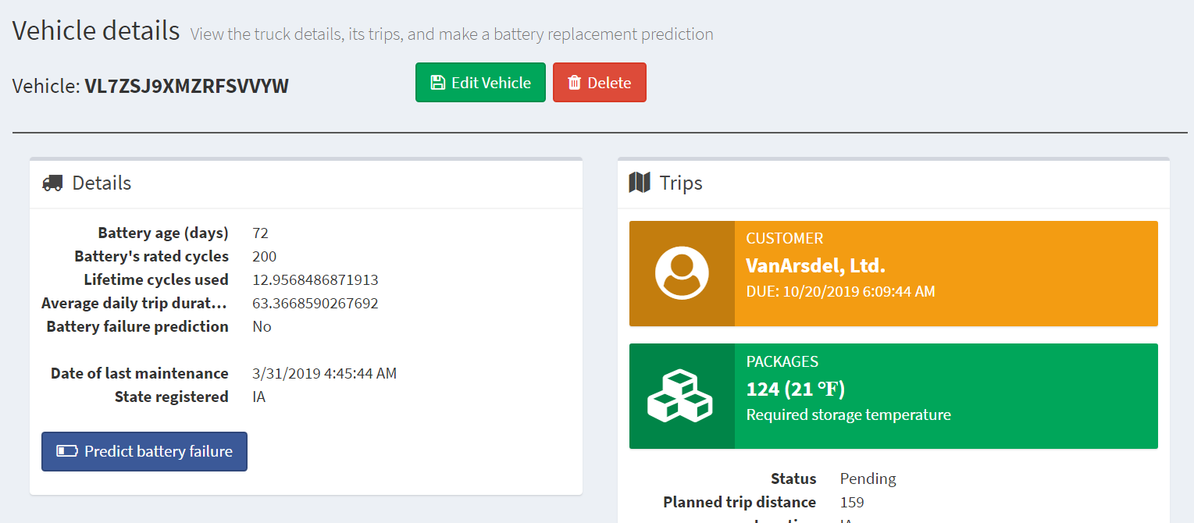
Example from lab: Embed vs. reference
Trip – has multiple packages
Package – details about each package

Slide 43
Trip entity
Package entity
[{
"id": "e2c7ca5e-2ef1-4ac2-836d-74124811516c",
"partitionKey": "DB2JXBWBLCL09FJFU",
"entityType": "Trip",
"vin": "DB2JXBWBLCL09FJFU",
"consignmentId": "1f145aad-d943-44c7-b0f3-1bc8562c7628",
"plannedTripDistance": 190.53,
"location": "OR",
…
"status": "Pending",
"timestamp": "0001-01-01T00:00:00",
"packages": [
{
"packageId": "514edbdc-210b-45f8-b05f-d491d6ded7e4",
"storageTemperature": 22,
"highValue": false
},
……
{
"packageId": "26128844-cc3f-4808-99f7-2b142ad002e5",
"storageTemperature": 32,
"highValue": false
}
],
"consignment": {
"consignmentId": "1f145aad-d943-44c7-b0f3-1bc8562c7628",
"customer": "Bellows College",
"deliveryDueDate": "2019-10-20T05:56:44.7367547Z"
}]
[{
"id": "ad476b94-8b3a-4ab8-ba5f-b95ad75acd63",
"partitionKey": " 26128844-cc3f-4808-99f7-2b142ad002e5",
"entityType": "Package",
"tripId": "ed96feb9-957e-4d30-873e-7a4f12266022",
"consignmentId": "cb56399c-65b3-452b-89f0-d3b9bed5fa02",
"height": 33.37,
"length": 41.45,
"width": 20.96,
"grossWeight": 223.72,
"storageTemperature": 39,
"highValue": false,
"trip": {
"tripId": "ed96feb9-957e-4d30-873e-7a4f12266022",
"vin": "AESQX3ZKCFM25HNNE",
"plannedTripDistance": 137.09
},
"consignment": {
"consignmentId": "cb56399c-65b3-452b-89f0-d3b9bed5fa02",
"customer": "Lamna Healthcare Company",
"deliveryDueDate": "2019-10-20T08:26:44.7366267Z"
},
"timestamp": "0001-01-01T00:00:00",
}]
Select package info makes it easier to generate Trip summary info view

Slide 44

Change Feed

Slide 45
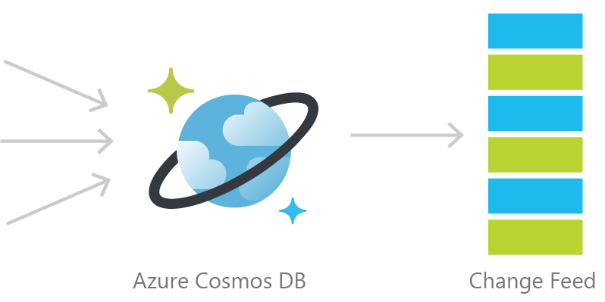
Cosmos DB Change Feed
Persistent log of documents within an Azure Cosmos DB collection in the order in which they were modified

Slide 46
Three different ways to use the Change Feed
Implementation | Use Case | Summary
Azure Functions | Serverless applications | Easy to implement. Used as a trigger, input or output binding to an Azure Function. Guarantees “at least once” semantics.
Change Feed Processor Library (deployed on own) | Distributed applications | Direct control over scale (you decide where Change Feed Processor Library is hosted). Checkpointing managed automatically. Guarantees “at least once” semantics
SQL API SDK for .NET or Java | Not recommended | Must manage both scaling and checkpointing logic

Slide 47
IoT-CosmosDBProcessing Function App
When did we read from the change feed?
TripProcessor – Triggered by write to telemetry container, then updates metadata container to update current trip status and consignment status. Sends alert email (if needed)
ColdStorage – Real-time writes to Azure Storage account
SendToEventHubsForReporting – Real-time writes to Event Hubs

Slide 48
Change Feed Processor Library – Behind the scenes
Telemetry
Write document A

Slide 49

Change Feed Processor Library – Behind the scenes
Telemetry
Write document A
TripProcessor Function executes

Slide 50
Change Feed Processor Library – Behind the scenes
Telemetry
TripProcessor Function immediately checks Telemetry container for any new updates

Slide 51
Change Feed Processor Library – Behind the scenes
Telemetry
Write document B
TripProcessor Function finds a new write of Document B and executes

Slide 52
Change Feed Processor Library – Behind the scenes
Telemetry
TripProcessor Function immediately checks Telemetry container for any new updates and doesn’t find anything.

Slide 53
Change Feed Processor Library – Behind the scenes
Telemetry
TripProcessor Function waits specified polling interval

Slide 54
Change Feed Processor Library – Behind the scenes
Telemetry
Write document C
TripProcessor Function finds a new write of Document C and executes

Slide 55
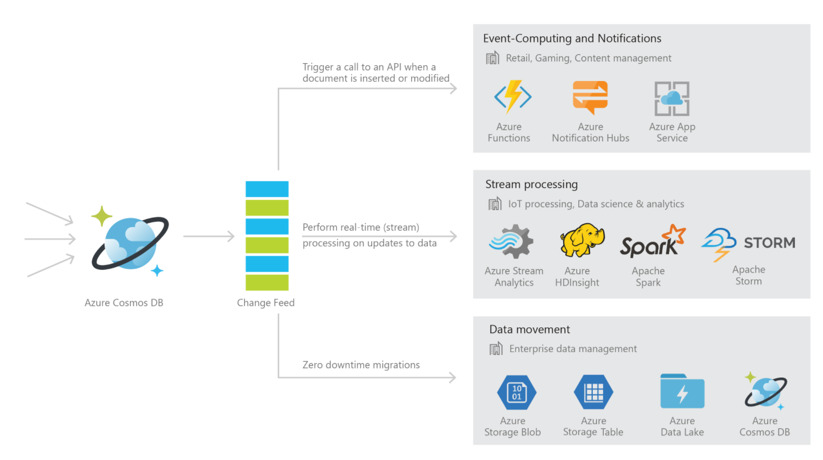
Common Change Feed Scenarios

Slide 56
Lease container
Document created for each physical partition to bookmark the latest processed document
In general, 400 RU’s should be enough for the lease collection. For very large workloads, you may need to increase up to a few thousand RU’s.
You should partition your lease collection by “id”

Slide 57


Common Scenarios
Event Sourcing (Microservices)
Read From Change Feed
Persistent Event Store
Microservice
#1
Microservice #2
New Order
Microservice #3
Trigger Action From Change Feed

Slide 58
What if we didn’t have the change feed?
Microservice 1: Tax Calculation
Microservice 2: Payment
Microservice n: Fulfillment
Microservice 3: Shipment Label

Slide 59
Not Scalable ☹

Slide 60
Event Sourcing to Microservices
Microservice 1: Tax
Azure Cosmos DB
Microservice 2: Payment
Microservice n: Fulfillment
Notes:
Event only processed once by Azure Cosmos DB
Each microservice subscribes to the change feed
Microservices have business logic
Independent, scalable

Slide 61
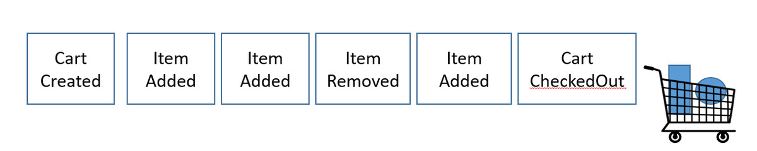
Event Sourcing
Each of these is an “event”
Notes:
Let’s look at use cases for event sourcing in retail
An example of an event is …
Jet.com build their architecture using event-sourcing

Slide 62
Event Sourcing
Shopping Cart State: Empty
Notes:
Let’s look at use cases for event sourcing in retail
An example of an event is …
Jet.com build their architecture using event-sourcing

Slide 63
Event Sourcing
Shopping Cart State: One item in cart
Notes:
Let’s look at use cases for event sourcing in retail
An example of an event is …
Jet.com build their architecture using event-sourcing

Slide 64
Event Sourcing
Shopping Cart State: Two items in cart
Notes:
Let’s look at use cases for event sourcing in retail
An example of an event is …
Jet.com build their architecture using event-sourcing

Slide 65
Event Sourcing
Shopping Cart State: One items in cart
Notes:
Let’s look at use cases for event sourcing in retail
An example of an event is …
Jet.com build their architecture using event-sourcing

Slide 66
Event Sourcing
Shopping Cart State: Two items in cart
Notes:
Let’s look at use cases for event sourcing in retail
An example of an event is …
Jet.com build their architecture using event-sourcing

Slide 67
Event Sourcing
Shopping Cart State: Empty
Payment function charged customer for their shopping cart contents
Notes:
Let’s look at use cases for event sourcing in retail
An example of an event is …
Jet.com build their architecture using event-sourcing

Slide 68
Event Sourcing to Microservices
Microservice 1: Tax
Azure Cosmos DB
Microservice 2: Payment
Microservice n: Fulfillment
Notes:
Event only processed once by Azure Cosmos DB
Each microservice subscribes to the change feed
Microservices have business logic
Independent, scalable

Slide 69
Key challenges
1. Guaranteed delivery
What if we miss an event in a customer order in retail?
2. Processing events in order
Events must be processed in the correct order for each consumer type
3. Replaying past events
How can using Azure Cosmos DB’s change feed help solve these common design challenges?

Slide 70
1. Guaranteed delivery
How can using Azure Cosmos DB’s change feed solve this?
Elastically scale throughput & storage
Azure Cosmos DB availability SLA: 99.999%
Azure Functions and Change Feed Processor library offer “at-least-once” semantics.

Slide 71
2. Processing events in order
How we do prevent this?

Slide 72
2. Processing events in order
hash(Partition Key)
…
What is a good partition key to ensure we process events in the correct order?

Slide 73
To ensure we always ship the correct items within a customer order, what should our partition key be?
Country
b. ItemCost
c. OrderId
d. Timestamp (current minute)

Slide 74
To ensure we always ship the correct items within a customer order, what should our partition key be?
a.
b.
c. OrderId
d.

Slide 75
2. Processing events in order
hash(OrderId)
…
Partition on OrderId to make sure each event within the same OrderId is processed in the correct sequence

Slide 76
3. Replaying past events
Scenario: There is an outage within a microservice

Slide 77
3. Replaying past events
Microservice 1: Tax
Azure Cosmos DB
Microservice 2: Payment
Microservice n: Fulfillment

Slide 78
3. Replaying past events
Microservice 1: Tax
Azure Cosmos DB
Microservice 2: Payment
Microservice n: Fulfillment

Slide 79
3. Replaying past events
Microservice 1: Tax
Azure Cosmos DB
Microservice 2: Payment
Microservice n: Fulfillment
Solution: You can replay events from the change feed

Slide 80
2. Real-time data movement
Backup Collection
Data Movement / Backup
Access upon main collection failure
Replicate Updates
Main Collection
Secondary Collections
CRUD Data
Read access, e.g. for analytics
…

Slide 81
2. Real-time data movement
This is useful for:
Performing a live migration from one Cosmos container to another
For example, to a container with a different partition key
Replicating data to another collection optimize for different read operations
For read-heavy workloads, sometimes it makes sense to replicate the same data two or more times (with different schema or different partition keys) to optimize for different read operation
Replicating data to another type of storage (colder storage such as Azure Blob Storage)
You can ingest data directly into Azure Cosmos DB and keep another data source synchronized. Then, you can set a TTL (time-to-live) on your Cosmos containers to have documents automatically deleted from Cosmos DB when the data is no longer “hot” and heavily accessed.

Slide 82
3. Materialized View
Application
Azure Cosmos DB
Materialized View
SubscriptionID | UserID | Create Date | …
123abc | Ben6 | 6/17/17
456efg | Ben6 | 3/14/17
789hij | Jen4 | 8/1/16
012klm | Joe3 | 3/4/17
UserID | Total Subscriptions
Ben6 | 2
Jen4 | 1
Joe3 | 1
Notes:
Demo available here: https://github.com/Azure-Samples/cosmosdb-materialized-views

Slide 83
IoT-CosmosDBProcessing Function App
TripProcessor – Triggered by write to telemetry container, then updates metadata container to update current trip status and consignment status.
ColdStorage – Real-time writes to Azure Storage account
SendToEventHubsForReporting – Real-time writes to Event Hubs

Slide 84
Code Walkthrough: Lease containers

Slide 85
Code Walkthrough: TripProcessor Function

Slide 86
Azure Cosmos DB Change Feed Summary
Automatically enabled in any Cosmos DB database account
Uses the existing allocated request units for processing events
Executed on insert and update operations. Delete support can be implemented by creating a property called isDeleted (or similar), modifying this property (to act as an update), and then setting a TTL on the document to delete it.

Slide 87
Thank you!
IOT lab: aka.ms/CosmosIOTLab
Retail lab: aka.ms/CosmosRetailLab
Additional labs: aka.ms/cosmosdbworkshop
Feedback survey: aka.ms/CosmosNZSurvey

Slide 88
Thank you!
IOT lab: aka.ms/CosmosIOTLab
Retail lab: aka.ms/CosmosRetailLab
Aka.ms/cosmosdbworkshop
Feedback Survey: https://aka.ms/CosmosAUWorkshopSurvey

Slide 89
Turnkey global distribution
PUT YOUR DATA WHERE YOUR USERS ARE IN MINUTES
Automatically replicate all your data around the world, and across more regions than AWS and Google Cloud Platform combined.
Available in all Azure regions
Manual and automatic failover
Automatic & synchronous multi-region replication

Slide 90
ELASTIC SCALE OUT OF STORAGE AND THROUGHPUT
SCALES AS YOUR APPS’ NEEDS CHANGE
Independently and elastically scale storage and throughput across regions – even during unpredictable traffic bursts – with a database that adapts to your app’s needs.
Elastically scale throughput from 10 to 100s of millions of requests/sec across multiple regions
Support for requests/sec for different workloads
Pay only for the throughput and storage you need

Slide 91
GUARANTEED LOW LATENCY
PROVIDE USERS AROUND THE WORLD WITH FAST ACCESS TO DATA
Serve <10 millisecond read and write requests at the 99th percentile from the region nearest to users, while delivering data globally.

Slide 92
FIVE WELL-DEFINED CONSISTENCY MODELS
CHOOSE THE BEST CONSISTENCY MODEL FOR YOUR APP
Offers five consistency models
Provides control over performance-consistency tradeoffs, backed by comprehensive SLAs.
An intuitive programming model offering low latency and high availability for your planet-scale app.
Strong
Bounded-stateless
Session
Consistent prefix
Eventual

Slide 93
Multiple data models and apis
USE THE MODEL THAT FITS YOUR REQUIREMENTS, AND THE APIS, TOOLS, AND FRAMEWORKS YOU PREFER
Choose from multiple APIs to access and query data, including SQL, MongoDB, Cassandra, Gremlin, Table, etcd, and Spark.
Use key-value, tabular, graph, and document data
Data is automatically indexed, with no schema or secondary indexes required.
Core (SQL) API
Table API
MongoDB
Column-family
Document
Key-value
Graph

Slide 94
COMPREHENSIVE SLAs
RUN YOUR APP ON WORLD-CLASS INFRASTRUCTURE
Azure Cosmos DB is the only service with financially-backed SLAs for single-digit millisecond read and write latency at the 99th percentile, 99.999% high availability and guaranteed throughput and consistency
Latency
High Availability
Throughput
Consistency
<10 ms
99.999%
Guaranteed
Guaranteed
99th percentile

Slide 95
Handle any data with no schema or indexing required
Azure Cosmos DB’s schema-less service automatically indexes all your data, regardless of the data model, to delivery blazing fast queries.
Automatic index management
Synchronous auto-indexing
No schemas or secondary indices needed
Works across every data model
GEEK
Item | Color | Microwave safe | Liquid capacity | CPU | Memory | Storage
Geek mug | Graphite | Yes | 16ox | ??? | ??? | ???
Coffee Bean mug | Tan | No | 12oz | ??? | ??? | ???
Surface book | Gray | ??? | ??? | 3.4 GHz Intel Skylake Core i7-6600U | 16GB | 1 TB SSD

Slide 96
Trust your data to industry-leading Security & Compliance
Azure is the world’s most trusted cloud, with more certifications than any other cloud provider.
Enterprise grade security
Encryption at Rest
Encryption is enabled automatically by default
Comprehensive Azure compliance certification

Slide 97


Data distributed and available globally
Put your data where your users are to give real-time access and uninterrupted service to customers anywhere in the world.
Turnkey global data replication across all Azure regions
Guaranteed low-latency experience for global users
Resiliency for high availability and disaster recovery
Azure region A
<10 ms
Azure Cosmos DB (app + session state)
Browser
Azure Traffic Manager
Azure region B
<10 ms
Globally distributed across regions
Azure region C
<10 ms

Slide 98



Build Real-Time Customer experiences
Online Recommendations Service
HOT path
Offer latency-sensitive applications with personalization, bidding, and fraud-detection.
Machine learning models generate real-time recommendations across product catalogues
Product analysis in milliseconds
Low-latency ensures high app performance worldwide
Tunable consistency models for rapid insight
Azure Service Fabric
(Personalization Decision Engine)
Azure Cosmos DB
(distributed model store)
Azure Data Factory
(scheduled job to refresh persisted models)
Shoppers
.com
(Product Details Page)
Azure Event Hub
Azure Data Lake Storage
(offline raw data)
Apache Spark on Azure HDInsight
Offline Recommendations Engine COLD path

Slide 99


Ideal for gaming, IoT and ecommerce
Maintain service quality during high-traffic periods requiring massive scale and performance.
Instant, elastic scaling handles traffic bursts
Uninterrupted global user experience
Low-latency data access and processing for large and changing user bases
High availability across multiple data centers
Azure CDN
Azure Storage (Game files)
Azure API Apps (Game backend)
Azure Cosmos DB (Game database)
Azure HDInsight (Game analytics)
Azure Functions
Azure Notification Hub (Push notifications)

Slide 100





Massive Scale Telemetry Stores for IOT
Diverse and unpredictable IoT sensor workloads require a responsive data platform
Seamless handling of any data output or volume
Data made available immediately, and indexed automatically
High writes per second, with stable ingestion and query performance
Azure IoT Hub
Apache Storm on Azure HDInsight
Azure Cosmos DB
(Telemetry & device state)
Azure Web Jobs (Change feed processor)
Azure Storage (archival)
Logic apps

Slide 101
simplified development with serverless architecture
Azure Functions
(E-commerce Checkout, API)
Azure Cosmos DB
(Order event score)
Experience decreased time-to-market, enhanced scalability, and freedom from framework management with event-driven micro-services.
Seamless handling of any data output or volume
Data made available immediately, and indexed automatically
High writes per second, with stable ingestion and query performance
Real-time, resilient change feeds logged forever and always accessible
Native integration with Azure Functions
Change feed
Azure Functions
(Microsoft 1: Tax)
Azure Functions
(Microsoft 2: Payment)
Azure Functions
(Microsoft N: Fulfillment)

Slide 102


Run spark over operational data
Accelerate analysis of fast-changing, high-volume, global data.
Real-time big data processing across any data model
Machine learning at scale over globally-distributed data
Speeds analytical queries with automatic indexing and push-down predicate filtering
Native integration with Spark Connector
Data nodes
Master node
Gateway nodes
Spark-Cosmos DB connector (Java)
Worker nodes

Slide 103
MIGRATE nosql apps
Make data modernization easy with seamless migration of NoSQL workloads to the cloud.
Azure Cosmos DB MongoDB API, Cassandra API, and SQL API bring app data from existing NoSQL deployments
Leverage existing tools, drivers, and libraries, and continue using existing apps’ current SDKs
Turnkey geo-replication
No infrastructure or VM management required
Cassandra
MongoDB
DynamoDB
Couchbase
NoSQL wire protocol
Neo4j
Azure Cosmos DB MongoDB API
Azure Cosmos DB Cassandra API
Azure Cosmos DB SQL API
HBase
CouchDB

Slide 104
All Common Use Cases & Scenarios
Retail/e-commerce
Manufacturing
Financial Services
Logistics
Gaming (Asia and W. USA)
Sectors
Device Telemetry (IoT)
Device Registry
Supply Chain Management
Device Telemetry (IoT)
Device Registry
Supply Chain Management
Order Processing Pipeline
Real-time operational analytics
Audit Trail
Tax Forms
Risk Analysis
Social Clans/Guilds
Leaderboards
Messaging
Personalization and recommendations
Customer 360
Order Processing Pipeline
Product Catalog
Supply Chain Management
Real-time operational analytics
Notes:
In addition, we see the following:
Healthcare
Data Interchange (HL7 FHIR)
ISV
Content Management (CMS)
Data Interchange
Dev Ops Dependency Management
Knowledge Graphs

Slide 105
Azure cosmos db
A globally distributed, massively scalable, multi-model database service.
MongoDB, Cassandra, Gremlin/graph, table, and NoSQL APIs
Elastic scale of storage and throughput
Multiple, well-defined consistency models
<10ms read and write latency guarantee
99.999% high-availability guarantee
Industry-leading SLAs across performance, latency, availability and throughput
Migrate NoSQL data and apps
Use multiple data and consistency models
Build real-time customer experiences
Ideal for IoT, gaming and eCommerce

Slide 106
Appendix
Customer case studies

Slide 107

Domino’s Pizza delivers through globally-distributed apps
Tech-centric consumers across continents demand instant access and uninterrupted service
99.99% uptime
Millisecond load latency
Globally distributed order-processing
Azure region A
<10 ms
Azure Cosmos DB (app + session state)
Browser
Azure Traffic Manager
Azure region B
<10 ms
Globally distributed across regions
Azure region C
<10 ms

Slide 108
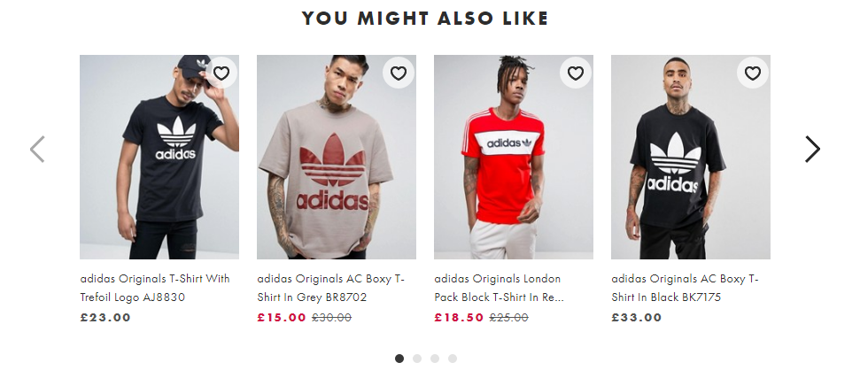

ASOS delivers personalization to 15mm customers
Online Recommendations Service (hot path)
Azure Service Fabric
(Personalization Decision Engine)
Azure Cosmos DB
(distributed model store)
Personalized shopping experiences and real-time order updates win with millennial shoppers
Machine learning models generate real-time recommendations across 85,000 products
Product analysis in milliseconds
Low-latency ensures fast page loads
Shoppers
ASOS.com
(Product Details Page)
Azure Data Factory
(scheduled job to refresh persisted models)
Azure Event Hub
Azure Data Lake Storage
(offline raw data)
Apache Spark on Azure HDInsight
Offline Recommendations Engine (cold path)

Slide 109
Jet.com flies through busy retail peaks
Black Friday, Cyber Monday, and other high traffic periods threaten service quality
Immediate inventory updates
Real-time change feeds
Low latency for swift processing
Browser
Azure Web App
(e-commerce web)
Azure Cosmos DB
(Product catalog)
Azure Search (Full-text index)
Azure Storage
(Logs, static catalog content)
Azure Cosmos DB
(Product catalog)

Slide 110
Toyota steers IoT telemetrics toward the future
Diverse and unpredictable IoT sensor workloads require a responsive data platform
Real-time vehicle diagnostics
Instant elastic scaling
No loss in ingestion or query performance
Azure IoT Hub
Apache Storm on Azure HDInsight
Azure Cosmos DB
(Telemetry & device state)
Azure Web Jobs (Change feed processor)
Azure Storage (archival)
Logic apps

Slide 111


Next Games RPG springs to life with Azure Cosmos DB
Need for a DB that to seamlessly respond to massive scale and performance demands
Multi-player game play with low latency
Instant capacity scaling from launch onward
Uninterrupted global user experience
Azure CDN
Azure Storage (Game files)
Azure API Apps (Game backend)
Azure Cosmos DB (Game database)
Azure HDInsight (Game analytics)
Azure Functions
Azure Notification Hub (Push notifications)

Slide 112
Top 10 reasons why customers use Azure Cosmos DB
The 1st and only database with global distribution turnkey capability
Deliver massive storage/throughput scalability database
Provides guaranteed single digit millisecond latency at 99th percentile worldwide
Natively supports different types of data at massive scale
Boasts 5 well-defined consistency models to pick the right consistency/latency/ throughput tradeoff
Enables mission critical intelligent applications
Gives high flexibility to optimize for speed and cost
Tackles big data workloads with high availability and reliability
Provides multi-tenancy and enterprise-grade security
Naturally analytics-ready and perfect for event-driven architectures

Slide 113

WELCOME TO AZURE COSMOS DB
Start free at www.AzureCosmosDB.com

